Slide 1

School Management System
By
PS/2019/279 - Arshana Sagadevan
PS/2019/051 - Pitipanage Malaka Dilshan
PS/2019/181 - Sashini Udyani Jayawardhana
PS/2019/233 - Daluwakgodage Dulakshi Anuradha
PS/2019/195 - Wathsala Wimansani Ranasingha

Slide 2


Introduction

Slide 3

School management systems become an integral a part of the upper education system.
We create it for to make the works easier to management system for the principal.
The executive aspects of such systems could include class rosters and therefore the ability to record students' grades.

Slide 4

With relevance the teaching aspects, however, it might include Servant details, Tenders information and treasury information as well.
School management system can handle all the detail about a student or a teacher.The details include college details, students personal details, academic details etc.

Slide 5


Classes and their attributes and methods

Slide 6
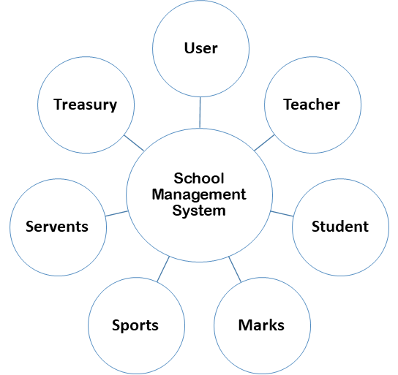

Slide 7
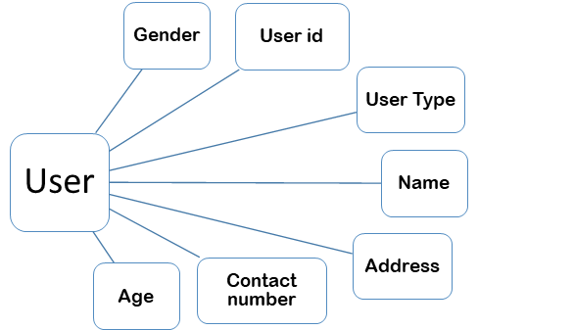
User class represents the users of the system.
Teacher, Student, Servant are some users of the proposed system.

Slide 8
All these attributes and methods are inherited by child classes. Firstly, user must create a profile.
In order to log in to the system user has to give correct username and password.
If the username and password are incorrect, they cannot log in to the system. After login to the system, they can view their profile.
Then if they want, they can update their details in the update profile section.

Slide 9
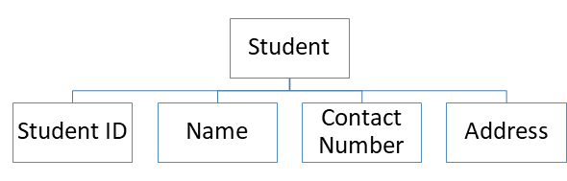
The student class has four properties namely Student ID, Name, Contact number, Address.
All these properties have respective methods to get and set object values.
Used ArrayList for collection framework

Slide 10
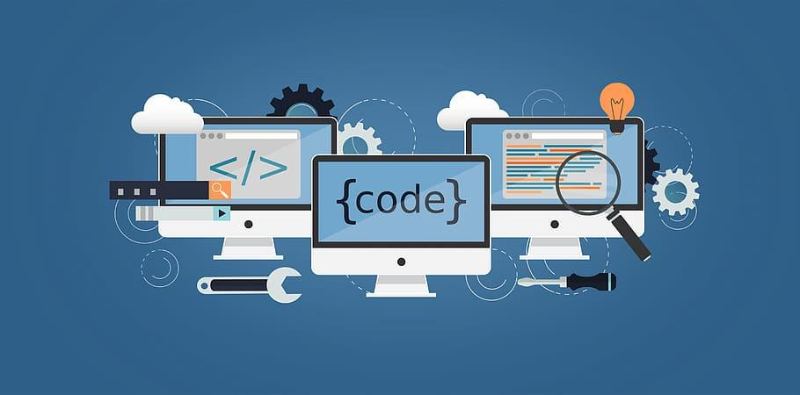
Use exception handling to avoid from the exceptions occurs when run time.
The purpose of this class is to maintain student details.
All these attributes and methods are inherited by child
classes.

Slide 11

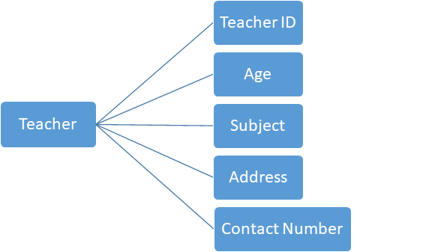
The teacher class has five properties namely Teacher ID, Age, Subject, Address, Contact number.
All these properties have respective methods to get and set object values. Used ArrayList for collection framework.
The purpose of this class is to maintain teachers details.

Slide 12
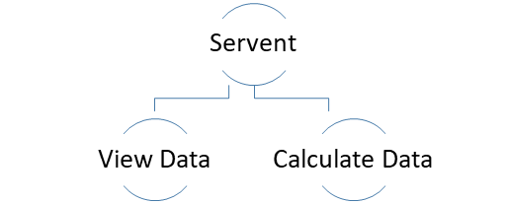
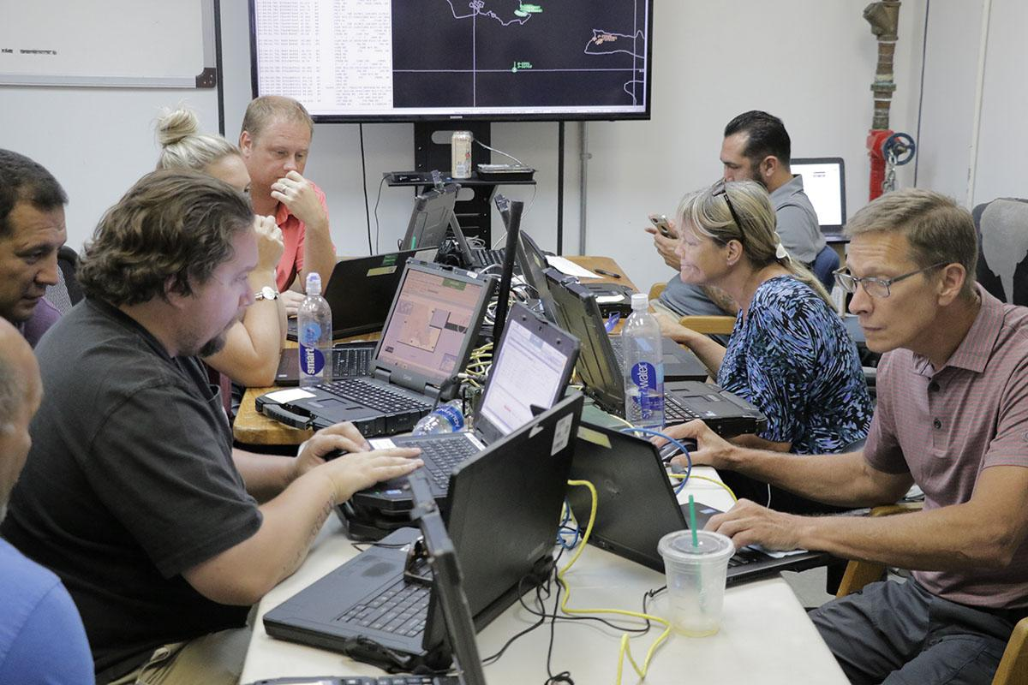
This class is designed to retain details of school workers and calculate their monthly salary.

Slide 13

This required the names, age, daily salary, allowances, etc. of the employees employed as data.
There are two methods in servant class.
1) Salary
2) View Data

Slide 14
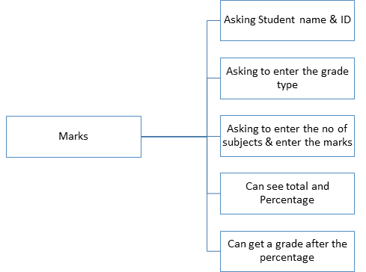


Slide 15
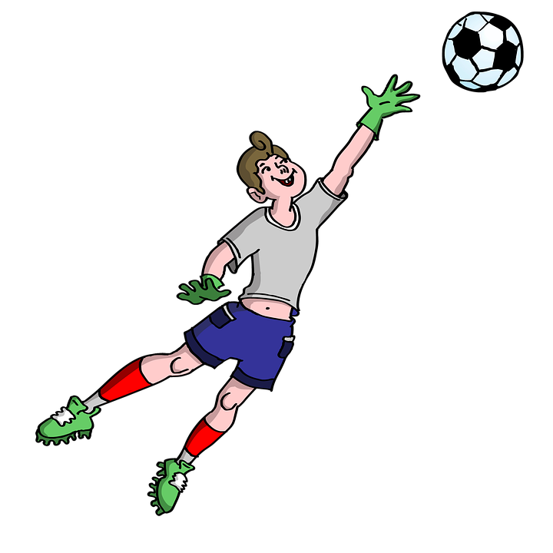
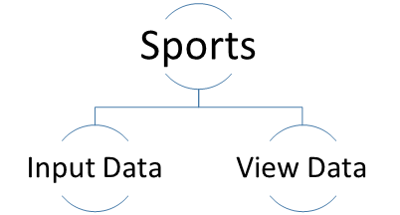
This sports class is designed to collect data related to each sport.
Accordingly, the coaches, teachers in charge and training dates and times related to each sport are collected as data.

Slide 16
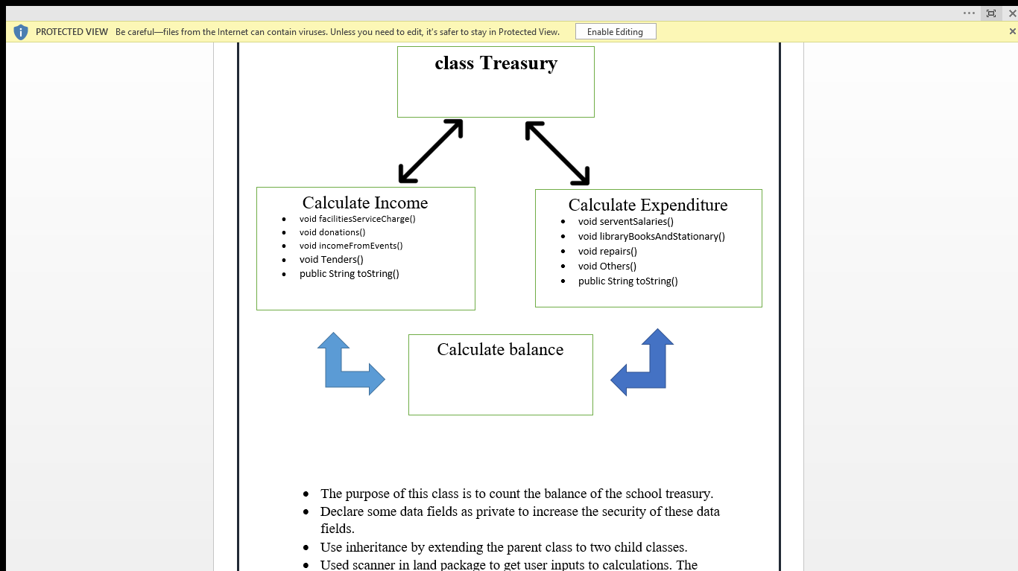
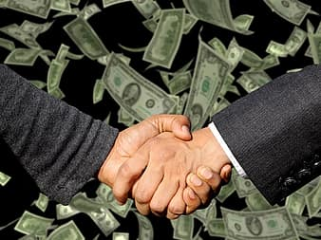

Slide 17
The purpose of this class is to count the balance of the school treasury.
Declare some data fields as private to increase the security of these data fields.
Use inheritance by extending the parent class to two child classes.
Used scanner in land package to get user inputs to calculations. The scanner variable is defined in the abstract class. Hence both the Income and Expenditure classes can use the scanner variable via inheritance.

Slide 18
This project “School Management System” provides a simple interface for maintenance of student information.
It can be used by educational institutes or colleges to maintain the records of students easily.
Achieving this objective is difficult using a manual system as the information is scattered, can be redundant and collecting relevant information may be very time consuming.
All these problems are solved using this project.

Slide 19
Throughout the project the focus has been on presenting information in an easy and intelligible manner.
The project is very useful for those who want to know about School Management Systems and want to develop program based on the same concept.

Slide 20

The project provides facilities like registration and profile creation of students thus reducing paperwork and automating the record generation process in an educational institution.

Slide 21

Challenges & Solutions
There were various errors came up while developing the program. To correct them, we refer some additional books as well as additional programs and lecture notes.
We were correct some errors by discussing with all the team members and changing some points in our system.

Slide 22
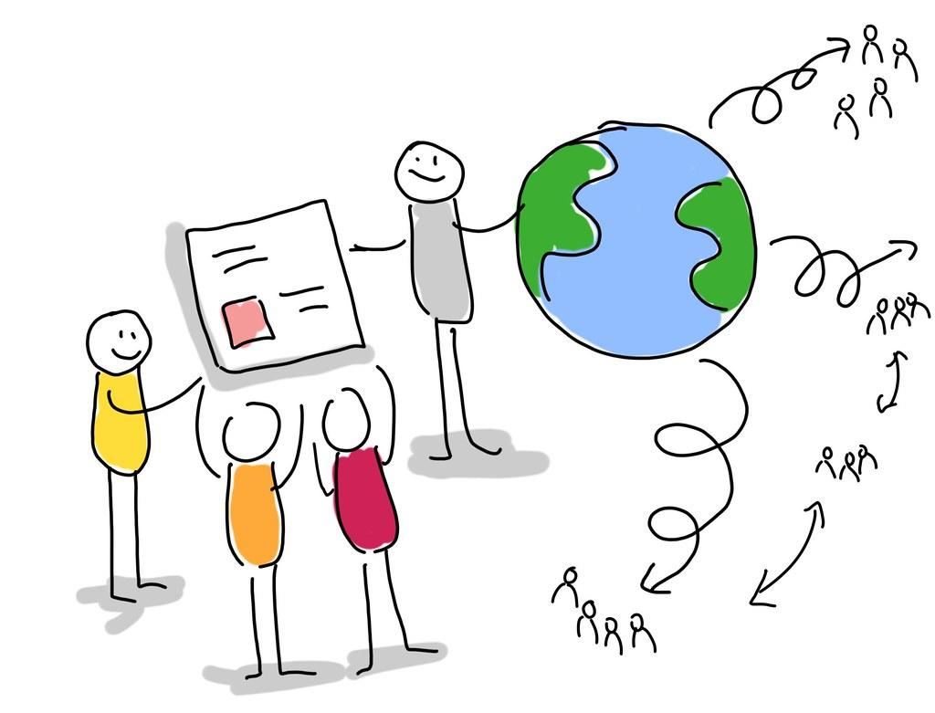
PS/2019/279 - Arshana Sagadevan – Developing Marks class
PS/2019/051 - Pitipanage Malaka Dilshan - Developing Treasury class
PS/2019/233 - Daluwakgodage Dulakshi Anuradha - Developing Servant class and Sports class
PS/2019/181 - Sashini Udyani Jayawardhana - Developing User class
PS/2019/195 - Wathsala Wimansani Ranasingha - Developing Student class and Teacher class
Teamwork

Slide 23
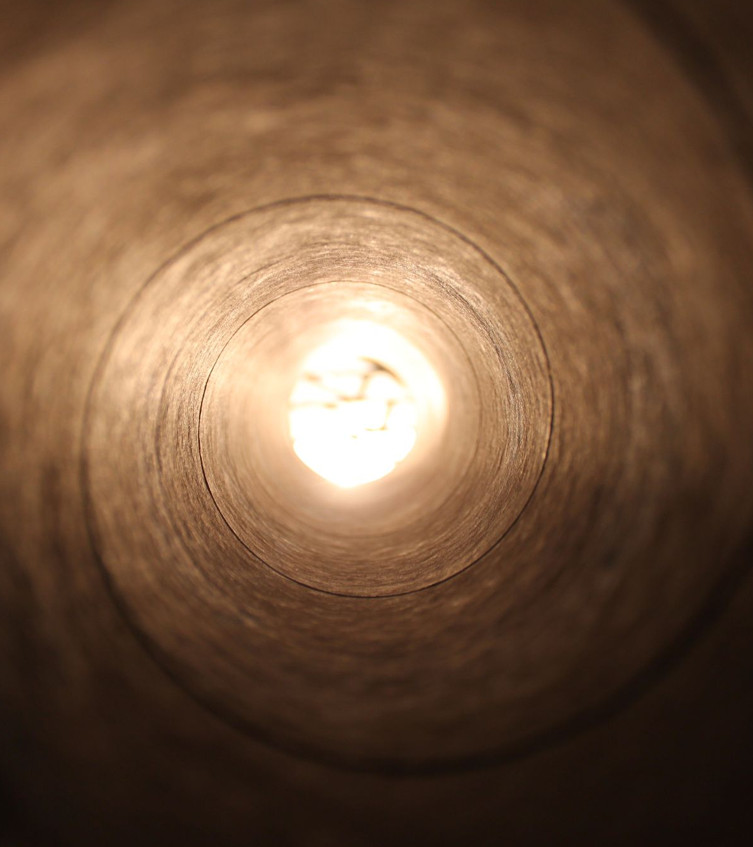

Thank You!

